Slide 1
The nine enneagram
Personality Types

Slide 2
Prepared By
1- Reham Taher Mohamed Elmshd
2- Shatha Shaban Tawfik Alberry
3- Sarah Mohamed Abdelrahman Abdelkhalek

Slide 3
What Are Enneagrams?
The Enneagram system uses different personality types to help people better understand themselves and what motivates them. Exact origins of the Enneagram system are a bit murky, but researchers note that its roots trace back to South American philosopher Oscar Ichazo in the mid-20th century.
The system has been used by psychiatrists since the 1970s, according to researchers, who note that the theory “proposes that by adulthood, individuals have developed a predominant personality strategy to cope with the external environment.”

Slide 4
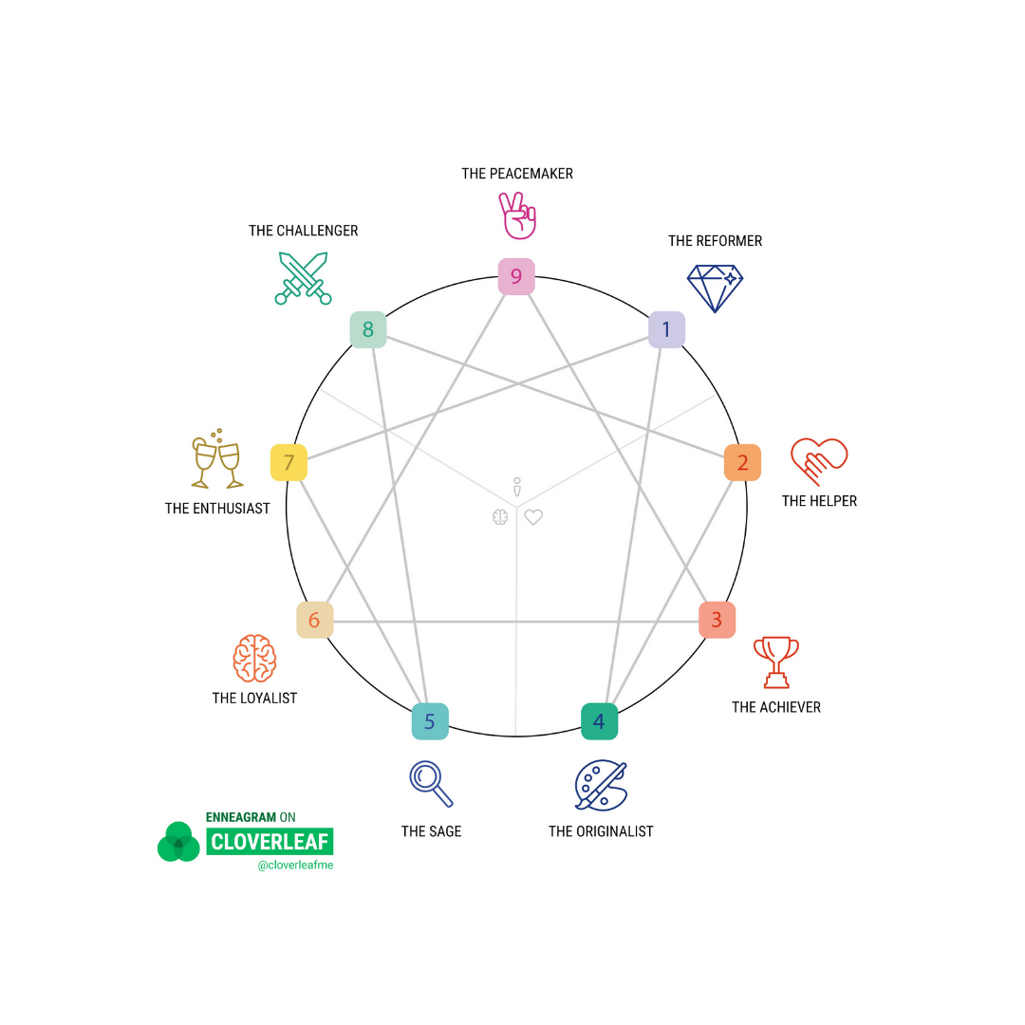
How Many Enneagram Types Are There?
There are nine Enneagram types, and the general idea is that everyone is assigned one type. Each type has “an associated fear, basic desire and predictable pattern of behavior in times of stress and security,” according to the American Journal of Psychiatry.

Slide 5
Type One: The Perfectionist
The message in childhood could be : You can't make a mistake
Basic desire: To be good or have integrity
Basic fear: To be bad or corrupt
Reformer name: Seeker of perfection
Natural: Type Ones focus on following the rules and doing things the right way. They are motivated by their desire to live the “right” way and to always avoid fault and blame. They are so intent on being perfect that it can backfire, and they can often be too hard on themselves and on others.

Slide 6
Strengths: Ethical, dedicated, reliable, strives to help themselves and others be the best they can be
Under Pressure: The need to feel complete - Unhappy with reality - Extremist - Afraid to make mistakes Pessimistic - Judging others - Hesitant (All or nothing) - Trying to walk others in his own way - Hunting for mistakes - Stressed - self-righteous
Sin: Anger
Blind Self: Criticism

Slide 7
Type Two: The Helper
The message in childhood could be: You should not have personal requests
Basic desire: To be loved
Basic fear: Being unworthy of being loved; being unwanted
Reformer name: Contact finder
Natural: As the name suggests, Type Twos are always there to lend a hand and act as a support system for family and friends. They are motivated by their need to be loved and needed at all times. They’re extremely giving to the point of ignoring their own needs. They really want to be liked and have a strong fear of being disliked by others, so they will do anything to ensure that they fit in. They tend to ignore their own boundaries for the sake of others.

Slide 8
Strengths: Caring, interpersonal, warm, giving, values relationships and service
Under Pressure: The need to feel that people need him - he does not respect limits - he is not appreciated - he is not interested in his personal needs
Sin: Pride
Blind Self: Urgency

Slide 9
Type Three: The Achiever
The message in childhood could be: We would love you if...
Basic desire: To be valuable and accepted
Basic fear: To be worthless or insignificant; to disappoint others
Reformer name: The Achiever Excellence Seeker
Natural: Type Threes are success-oriented and extremely driven. They are motivated by their constant need to be successful—or at least to look successful to others. They do everything they can to avoid failure. They never want to look like they don’t know what they’re doing, and they put a little too much focus on what others think of them.

Slide 10
Strengths: Adaptable and able to succeed in almost any situation; productive and image-conscious
Under Pressure: The urgent need for success, He is interested in his image more than the content, He talks about his achievements, He accepts a job that exceeds his capacity, He wants to be the center of attention and that all people know his successes, experiences and achievements, He seeks admiration and encouragement, He hates obstacles, He beautifies reality so people feel that there is a hidden need .
Sin: Deception
Blind Self: It may not be Authentic

Slide 11
Type Four: The Individualist
The message in childhood could be: You can't be too imaginative
Basic desire: To be meaningful based on their inner experience
Basic fear: To have no identity or personal significance
Reformer name: The seeker of excellence
Natural: Type Fours are motivated by the need to be as unique as possible—they never want to be ordinary. They are also very focused on feeling all of their emotions. Their moodiness can hinder them, and they have a fear of being flawed.

Slide 12
Strengths: Creative, sensitive, introspective, unique, understanding, empathetic
Under Pressure: The urgent need to pamper oneself - distanced - isolated - no one understood me - sad - no commitment to the specified time
Sin: Comparison
Blind Self: Self-preoccupation

Slide 13
Type Five: The Investigator
The message in childhood could be: You can't be comfortable in this world
Basic desire: To be capable and competent
Basic fear: To be useless, helpless or incapable
Reformer name: The seeker of detachment
Natural: Also known as scientists or professors, Type Fives love to learn. They are constantly striving to conserve energy and learn more about the world, and this tends to make them very private and detached. They can be secretive and not very social.

Slide 14
Strengths: Knowledgeable, curious, insightful, analytical
Under Pressure: Specializes in unhelpful disciplines - isolation - refuses any attachment - does not show feelings and does not share ideas with others
Sin: Being careful
Blind Self: Intellectual Vanity

Slide 15
Type Six: The Loyalist
The message in childhood could be: You can't just depend on yourself
Basic desire: To have security and support
Basic fear: To be without security and support
Reformer name: The owner of loyalty - the faithful - the seeker of safety
Natural: Motivated by fear and the need for security, loyalists are the most common type. They value friendship and loyalty, but they are also worst-case-scenario thinkers. They like to be prepared for the worst and feel anxious if they don’t think they’re prepared.

Slide 16
Strengths: Committed, practical, witty, great in a crisis, always prepared
Under Pressure: Rigid beliefs - anxiety - excessive care - suspicious - hates risk - change - does not trust his opinion - hesitant - bureaucratic - tends to control - critical - quick to anger - feels threatened
Sin: Fear and anxiety
Blind Self: The complaint

Slide 17
Type Seven: The Enthusiast
The message in childhood could be: You can't depend on anyone for anything
Basic desire: To be happy and satisfied
Basic fear: To be confined or in pain
Reformer name: The Wanderer - Thrill Seeker
Natural: A positive, fun-loving type, Type Sevens are spontaneous and motivated by a need to be happy. They never want to be tied down and are almost always full of energy. They never want to feel any kind of emotional pain or discomfort, so they do everything they can to keep themselves busy and having a good time

Slide 18
Strengths: Adventurous, always planning something fun, loves having new experiences
Under Pressure: Running away - narcissistic - emotional - rebellious - the love of possession starts things and does not complete them
Sin: Gluttony
Blind Self: Distracted

Slide 19
Type Eight: The Challenger
The message in childhood could be: It is not okay to be weak or to trust anyone
Basic desire: To be in control and protect self and others
Basic fear: To be harmed or controlled by others
Reformer name: Leader - Seeker of Strength
Natural: Type Eights are motivated by their need to always assert strength and control over everyone around them, and to never look weak and vulnerable. They can be described as defenders or protectors, and they always know what they want. They are leaders, but they are also obsessed with controlling everything around them.

Slide 20
Strengths: Commanding, direct, protective, very take-charge
Under Pressure: The need to feel in control - quarrels - rebellious - harsh - only concerned about herself - suspicious and aggressive
Sin: Sharpness
Blind Self: The desire to impose control

Slide 21
Type Nine: The Peacemaker
The message in childhood could be: It is not possible to be superior to an adult
Basic desire: To have peace and stability in their internal and external world
Basic fear: To be disconnected, separate and/or lost
Reformer name: Peacemaker - Seeker of Peace
Natural: Nines value harmony, comfort and peace. They are motivated by a need to always keep the peace and avoid conflict at all costs. They go with the flow and tend to let others take control so that they can make other people happy.

Slide 22
Strengths: Gentle - generous - loves harmony - calm - tends to balance - patient
Under Pressure: Ignores his needs - tends to forget - indifference - straying - aloof - hates conflict - does not confront
Sin: Laziness
Blind Self: Passive-Aggressive

Slide 23
How to Determine Your Enneagram Type
The best way to determine your Enneagram type is through a test or assessment
Take this test to determine your personality type:
https://masterthelifeyouwant.com/enneagram-assessment

Slide 24
Thank YOu

